Slide 1
Nottingham Attendance week assembly
Notes:
Please adapt these slides to meet the needs of your school and children. We would love to hear from schools that have used the assembly during the week of action or beyond, we are on Twitter @AchieveWellTeam or you can email us on achievewell@nottinghamcity.gov.uk
For this assembly, each child will need a post-it note or a slip of scrap paper to write their ideas for slide 19.

Slide 2
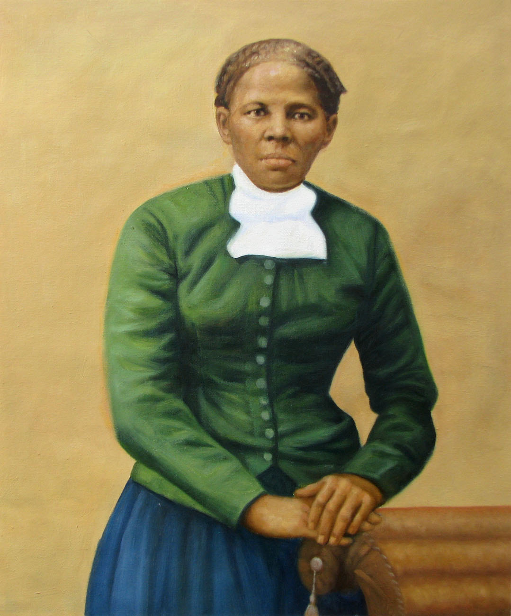
“Every great dream begins with a dreamer. Always remember you have within you the strength, the patience, and the passion to reach for the stars to change the world.”
Harriet Tubman
Notes:
Harriet Tubman (1822–1913) was an American abolitionist, political activist, and humanitarian best known for her role as a conductor on the Underground Railroad, where she helped enslaved people escape to freedom. Born into slavery, Tubman escaped herself and dedicated her life to fighting for the abolition of slavery and equal rights, later serving as a spy, nurse, and scout for the Union Army during the Civil War.

Slide 3
What is your biggest dream for your future?
Notes:
Ask the students to think about this question, they may also choose to discuss with the person next to them. If appropriate and time permits, ask a few students to share their dreams.

Slide 4
This week is Nottingham School Attendance Week
Across the City schools are focusing on supporting students to come to school every day.
We are going to consider how attending school every day can support you to achieve your dreams.

Slide 5
What do young people miss when they are absent from school?
Notes:
Ask students to discuss with the person next to them. Encourage them to think broadly in their responses to the question. Take some responses from the students.

Slide 6

Learning
Notes:
Falling behind in learning, making it harder to catch up, missing key concepts. Each lesson builds on the next, so if one or more are missed it becomes more difficult to understand the key concepts.

Slide 7

Social skills
Notes:
Regular school attendance is vital for developing social skills, it provides students with opportunities to interact with peers and adults, build friendships, and learn how to communicate effectively with a range of people. Missing school can hinder their ability to collaborate, adapt to social norms, and foster a sense of belonging.

Slide 8

Opportunities to build confidence
Notes:
Consistent school attendance plays a crucial role in helping students build self-confidence by allowing them to participate in activities that challenge their abilities, such as group projects or class discussions. When students are absent, they miss out on opportunities to overcome challenges, receive positive reinforcement, and develop the resilience needed to handle new social or academic situations, which are all essential for growing their confidence.

Slide 9

Extra-curricular activities
Notes:
Regular attendance at school ensures students can take part in extra-curricular activities, such as sports, clubs, or arts programmes, which are key to developing a range of skills and interests outside the classroom. Missing these activities can limit their ability to explore new passions, build teamwork skills, and gain a sense of achievement, which are all crucial for personal growth and overall development.

Slide 10

Support
Notes:
Consistent school attendance provides students with access to the various forms of support available at school, such as academic help, counselling, and guidance from teachers. When students miss school, they miss out on crucial opportunities to receive tailored support and feedback, making it harder to address challenges and stay on track with both academic and emotional development.

Slide 11

Exam preparation
Notes:
Regular attendance is essential for effective exam preparation, as it allows students to fully engage in lessons, review key concepts, and participate in discussions that reinforce learning. Missing school can lead to gaps in knowledge, making it difficult to keep up with the curriculum and adequately prepare for exams, which can impact performance and confidence during exams.

Slide 12

Life lessons
Notes:
Consistent school attendance provides students with valuable life lessons, such as time management, responsibility, and perseverance, that are learned through daily routines and challenges. Missing school reduces exposure to these experiences, which are essential for developing the skills needed to navigate both academic, personal and work challenges later in life.

Slide 13

Friendships
Notes:
Regular school attendance allows students to form and strengthen friendships by engaging in daily social interactions with their peers. Missing school limits these opportunities, making it harder for students to bond, develop trust, and build lasting relationships that are important for emotional support and social development.

Slide 14

Teacher feedback
Notes:
Consistent school attendance ensures that students receive timely feedback from teachers, which is essential for understanding their strengths and areas for improvement. Missing school can delay this crucial guidance, making it more challenging for students to stay on track, address misconceptions, and make necessary adjustments to their learning.

Slide 15

Opportunities
Notes:
Regular school attendance provides students with countless opportunities for personal and academic growth, including access to diverse learning experiences, extracurricular activities, and interactions with teachers and peers. Missing school limits these opportunities.

Slide 16
Think about your dream….which of these is most important to support you in achieving your dream?
Learning
Social skills
Opportunities to build confidence
Extra-curricular activities
Support
Exam preparation
Life lessons
Events
Friendships
Teacher feedback
Opportunities
Notes:
Ask students to consider for themselves and then discuss with the person next to them. If time allows, take some feedback.

Slide 17
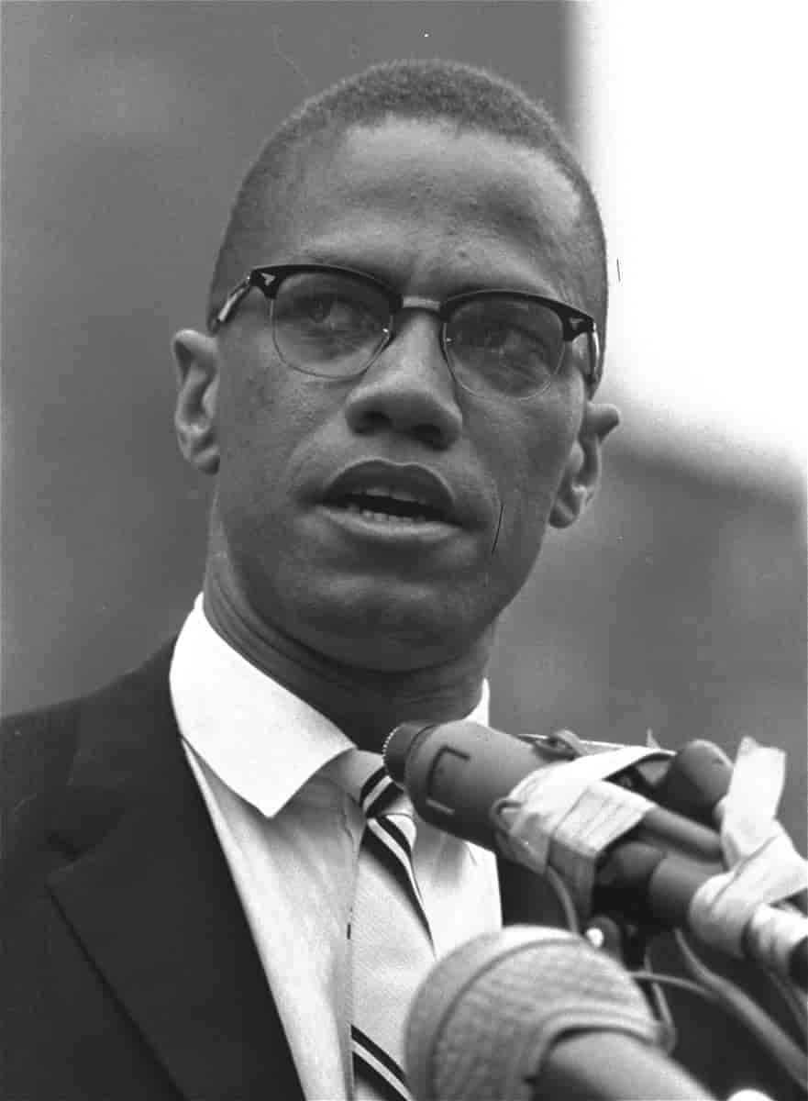
“Education is our passport to the future, for tomorrow belongs to the people who prepare for it today.”
Malcolm X
Notes:
Regular attendance is crucial because each school day provides unique experiences. While some missed work can be made up, other losses—like social bonds, practical skills, or inspirational moments—are harder to recover.
Ask students if they agree with the statement from Malcolm X.

Slide 18
What can students do to improve their attendance?
Set clear goals
Have consistent routines
Understand the importance of attendance
Stay organised
Make healthy choices
Improve motivation
Avoid procrastination
Celebrate achievements
Communicate
Seek support
Notes:
Share the title question, ask students to share their ideas. Then share the rest of the slide contents.

Slide 19
What can the school do to support attendance?
Write your responses on the slip and post in the boxes provided.
Notes:
Provide a box or basket for students to write down their ideas. Collate these, discuss as a staff and respond using a ‘You Said, We did’ approach.

Slide 20
Do you need support with attending school?
We are here to help.
Please speak with (fill in details for your school)
Notes:
Fill in this slide with the details for your school

